Slide 1


Shirsa Mukherjee
26.03.2022

Slide 2

Outline
Executive Summary
Introduction
Methodology
Results
Conclusion
Appendix

Slide 3
Executive Summary
Summary of methodologies
Data Collection - gathering data
Data Wrangling – cleaning & preparing data
Exploratory Data Analysis
Interactive Visual Analytics
Predictive Analysis
Summary of results
Exploratory Data Analysis results of SQL and visualization
Interactive analytics results of Folium and Dash
Predictive analysis results

Slide 4
Introduction
The commercial space age is here, companies are making space travel affordable for everyone. Talking about affordability, the agency that we can first think of is SpaceX which was founded in 2002 by Elon Musk with the goal of reducing space transportation costs. It’s accomplishments include: Sending spacecraft to the International Space Station. Starlink, a satellite internet constellation providing satellite Internet access and many more.
One reason SpaceX can do this is the rocket launches are relatively inexpensive, much of the savings is because SpaceX can reuse the first stage. Therefore, if we can determine if the first stage will land, we can determine the cost of a launch.
As a Data Scientist at SpaceY Corp., I will be predicting if the SpaceX Falcon 9 first stage will land successfully, if the first stage can be reused and as a result to determine the price of each launch. I will achieve this by training a machine learning model and use public information to make the required prediction.

Slide 5

Section 1

Slide 6
Methodology
Summary
Data collection methodology:
Obtained the launch data from SpaceX REST API & also by Web Scrapping with Beautiful Soup.
Perform data wrangling:
The booster landings outcomes are converted to training labels using Exploratory data analysis.
Perform exploratory data analysis (EDA) using visualization and SQL:
Performed visualization with pandas & matplotlib and executed SQL queries for EDA.
Perform interactive visual analytics using Folium and Plotly Dash:
Used Folium maps to find geographical patterns and built a dashboard with the Plotly Dash to get more insights.
Perform predictive analysis using classification models:
Built machine learning models to make the prediction and find best model.

Slide 7
Data Collection
The initial step of Collecting SpaceX Falcon 9 launch data is fulfilled using two methodologies as follows:
From API:- using the get() method from requests library the launch data is collected from SpaceX REST API.
From Web Page:- web scrapping Falcon 9 historical launch records from Wikipedia webpage titled ‘List of Falcon 9 and Falcon heavy launches’ with BeautifulSoup.

Slide 8
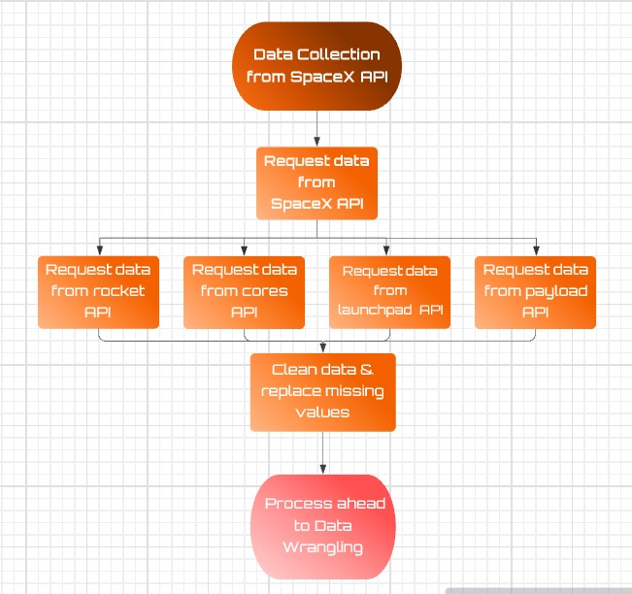
Data Collection – SpaceX API
Requested rocket launch data from SpaceX API using get() method from requests library.
Parsed the launch data to a JSON and then converted it to a dataframe.
Removed irrelevant features and removed all launches data except the Falcon 9 launches.
Replaced missing values with the mean of respective column.
GitHub URL of the completed Data Collection API notebook – Projects-Data-Science/Data Collection API notebook.ipynb at main · ShirsaM/Projects-Data-Science (github.com)

Slide 9
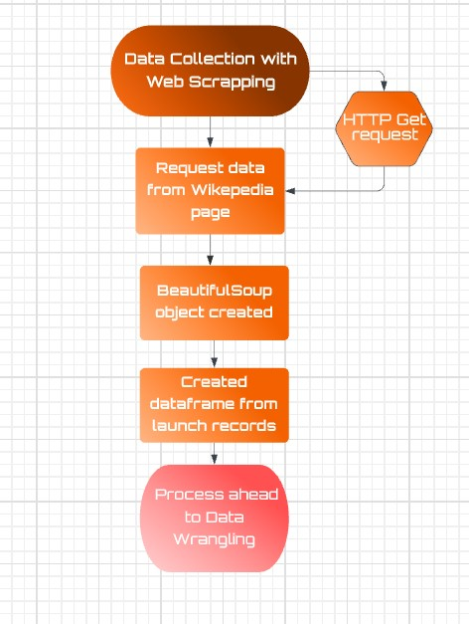
Data Collection - Scraping
Performed HTTP GET request to the Falcon9 Launch HTML page.
Created a BeautifulSoup object using response text content.
Created dataframe from parsed launch record values.
GitHub URL of the completed Data Collection using Web Scrapping – Projects-Data-Science/Step1- Data Collection with Web Scrapping.ipynb at main · ShirsaM/Projects-Data-Science (github.com)
Place your flowchart of web scraping here

Slide 10
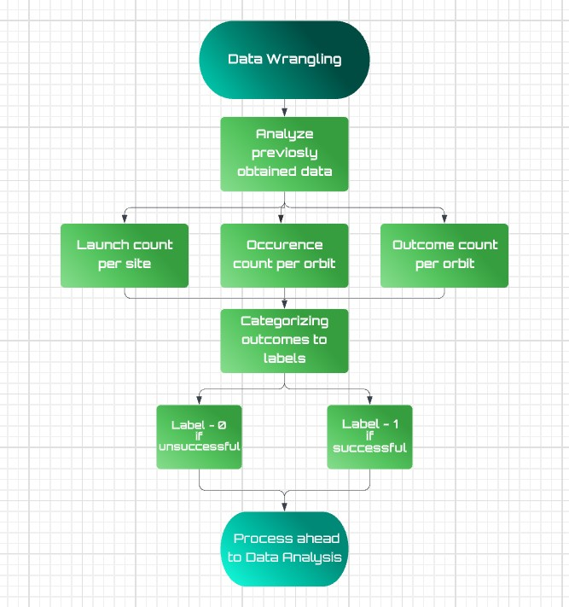
Data Wrangling
Analyzed the number of launches on each site, each orbit and outcome.
Categorized outcomes as landing labels, where 0 represents unsuccessful landing and 1 for successful landing.
Created a new dataframe with an added Class column containing the landing labels.
GitHub URL of the completed Data Wrangling notebook– Projects-Data-Science/Step-2 - Data Wrangling.ipynb at main · ShirsaM/Projects-Data-Science (github.com)

Slide 11
EDA with Data Visualization
Plots used for exploratory data analysis to visualize valuable insights.
Made scatter plots of
Flight Number vs Payload Mass
Flight Number vs Launch Site
Payload Mass vs Launch Site
Flight Number vs Orbit Type
Payload Mass vs Orbit Type, each with Class overlay.
Created bar plot to visualize success rate of each orbit.
Used line plot to visualize launch success yearly trend.
GitHub URL of the completed EDA with Data Visualization notebook– Projects-Data-Science/Step-3 - EDA with Pandas & Matplotlib.ipynb at main · ShirsaM/Projects-Data-Science (github.com)

Slide 12
EDA with SQL
Executed SQL queries for exploratory data analysis.
Displayed following SQL queries:-
Unique launch site names
5 launch sites starting with ‘CCA’
Total payload mass carried by NASA(CRS) boosters
Average payload mass carried by F9 v1.1 version
Date of first successful landing ground pad
Boosters that had success in drone ship & payload mass between 4000 & 6000
Total number of successful and failure mission outcomes
Booster Versions that carried maximum payload mass
Failed landing outcomes in drone ship, booster versions & launch sites for the year 2015
Rank in descending the landing outcome count between 2010-06-04 and 2017-03-20
GitHub URL of the completed EDA with Data Visualization notebook– Projects-Data-Science/Step-3 - Exploratory Data Analysis with SQL.ipynb at main · ShirsaM/Projects-Data-Science (github.com)

Slide 13
Build an Interactive Map with Folium
Folium map objects used to build an Interactive Map are markers, circles and polylines.
Created a map with center location as NASA Johnson Space Center at Houston, Texas, to visualize and draw insights of SpaceX launch sites.
Marked the success and failed launches for each site on the map using markers.
GitHub URL of the completed Data Visualization with Folium– Projects-Data-Science/Step-4 - Data Visualization with Dashboard.ipynb at main · ShirsaM/Projects-Data-Science (github.com)
For Map Outputs:-
Google Colab URL of the completed Data Visualization with Folium notebook– Copy of Step-4 - Data Visualization with Dashboard.ipynb - Colaboratory (google.com)

Slide 14
Build a Dashboard with Plotly Dash
Added a dropdown list of Launch Site names to enable selection.
Added a pie chart to the Dashboard showing comparison between success Vs failed launches of selected site or count of successful launches of all sites.
Added a slider to select payload mass range.
Added a scatter plot to show the correlation between payload mass and launch success.
GitHub URL of the completed Dashboard with Plotly Dash– Projects-Data-Science/Step4_spacex_dash_app.py at main · ShirsaM/Projects-Data-Science (github.com)

Slide 15
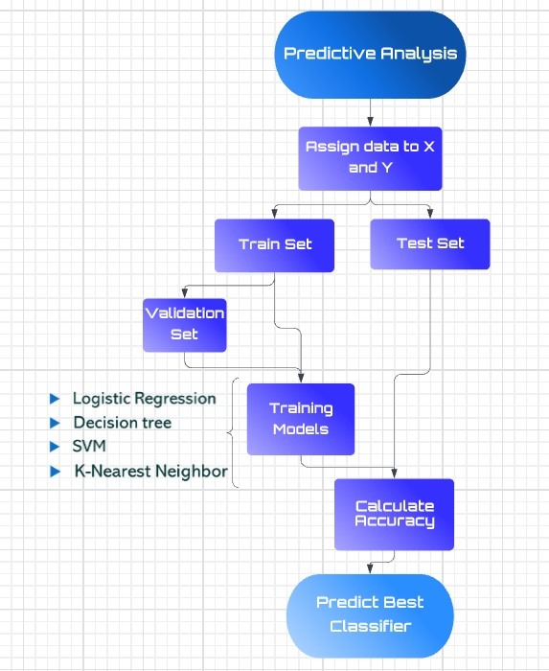
Predictive Analysis (Classification)
Obtained and standardized feature data in X and assigned Class data to Y.
Data spilt into train & test data and training data further divided to validation data.
Created models of Logistic Regression, Support Vector Machine, Decision tree classifier and K-Nearest Neighbor and calculated validation set accuracy and test set accuracy of each model.
Plotted Confusion Matrix of each model.
Observed that all four models have same accuracy score of 83.3% and hence cannot determine best classifier.
GitHub URL of the completed Dashboard with Plotly Dash– Projects-Data-Science/Step-5 Machine Learning Prediction.ipynb at main · ShirsaM/Projects-Data-Science (github.com)

Slide 16
Results
Exploratory data analysis results:
As the flight number increases, the first stage is more likely to land successfully.
Rockets with payload mass less than 8000kg are highly preferred for launches.
Orbits ES-L1, GEO, HEO, SSO have the highest success rates.
Since 2013, the launch success rate kept increasing till 2020.
First successful landing outcome on ground pad was on 2015-12-22.
Interactive analytics results:
Site KSC LC-39A has the highest success rate & CCAFS LC-40 has lowest.
Launch sites are in close proximity to railways, highways and coastline but located far away from the cities.
Predictive analysis results:
All the four classification models have the same Accuracy Score which is 0.833.

Slide 17

Section 2

Slide 18
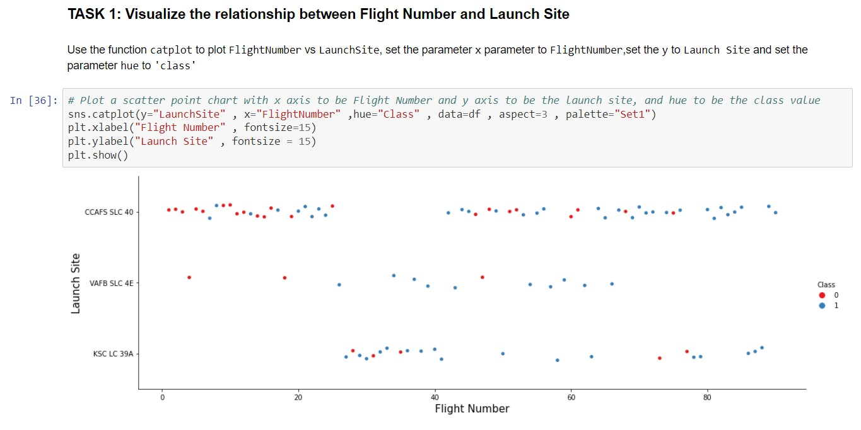
Flight Number vs. Launch Site
Observations of scatter plot of Flight Number vs. Launch Site with Class as overlay:-
Launch sites KSC LC-39A and have higher success rates than VAFB SLC 4E and CCAFS LC-40.
As the flight number increases, the first stage is more likely to land successfully

Slide 19
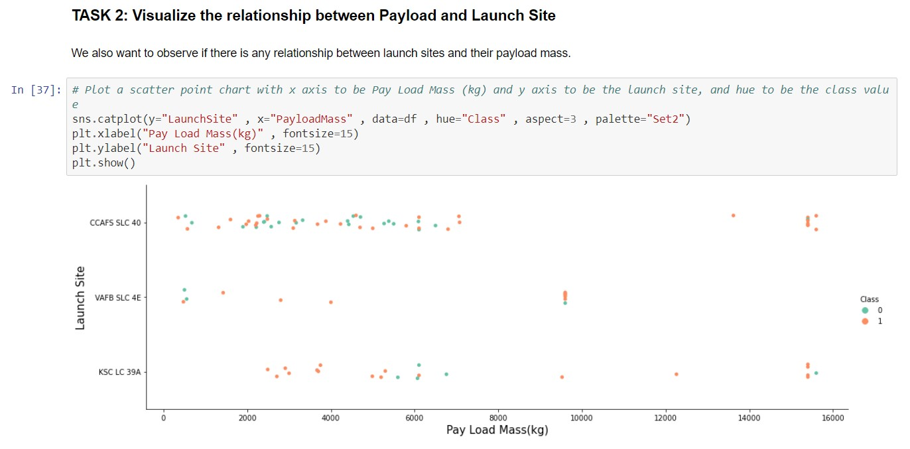
Payload vs. Launch Site
Observations of scatter plot of Payload Mass vs. Launch Site with Class as overlay:-
Rockets with payload mass less than 8000kg are highly preferred for launches.
No rockets launched from VAFB SLC 4E launch site having payload mass greater than 10000kg

Slide 20
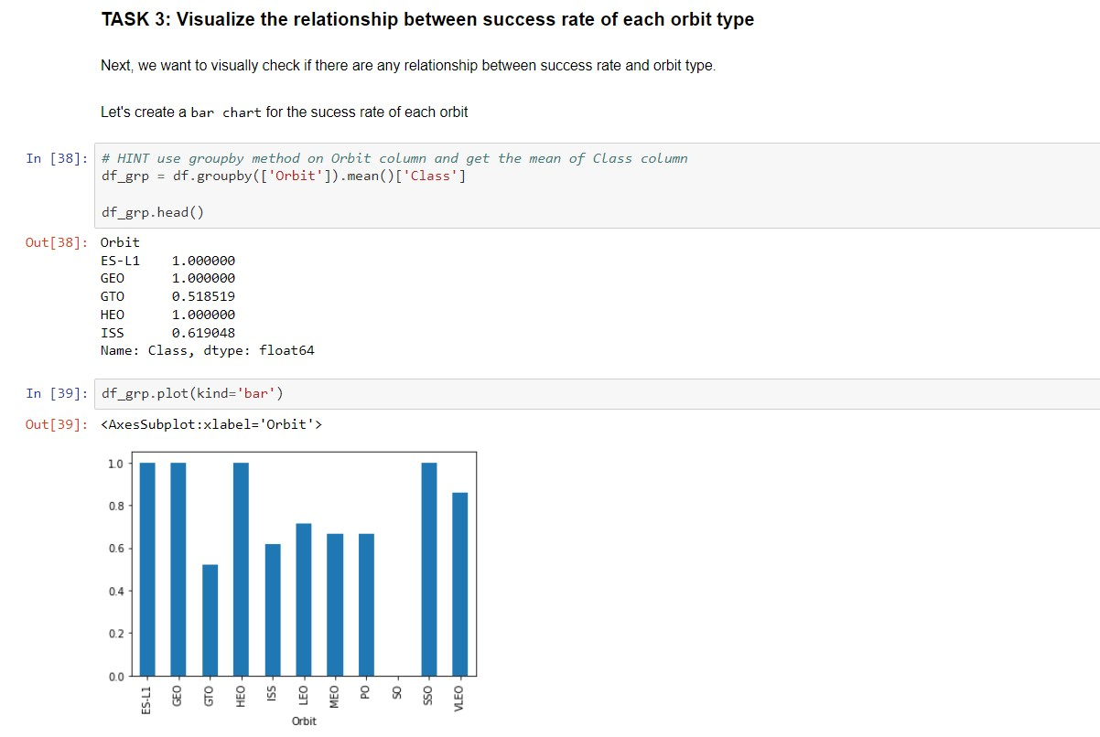
Success Rate vs. Orbit Type
Observations of bar plot of Success Rate vs. Orbit Type:-
Orbits ES-L1, GEO, HEO, SSO have the highest success rates.
Approximately no success rate for orbit type ‘SO’

Slide 21
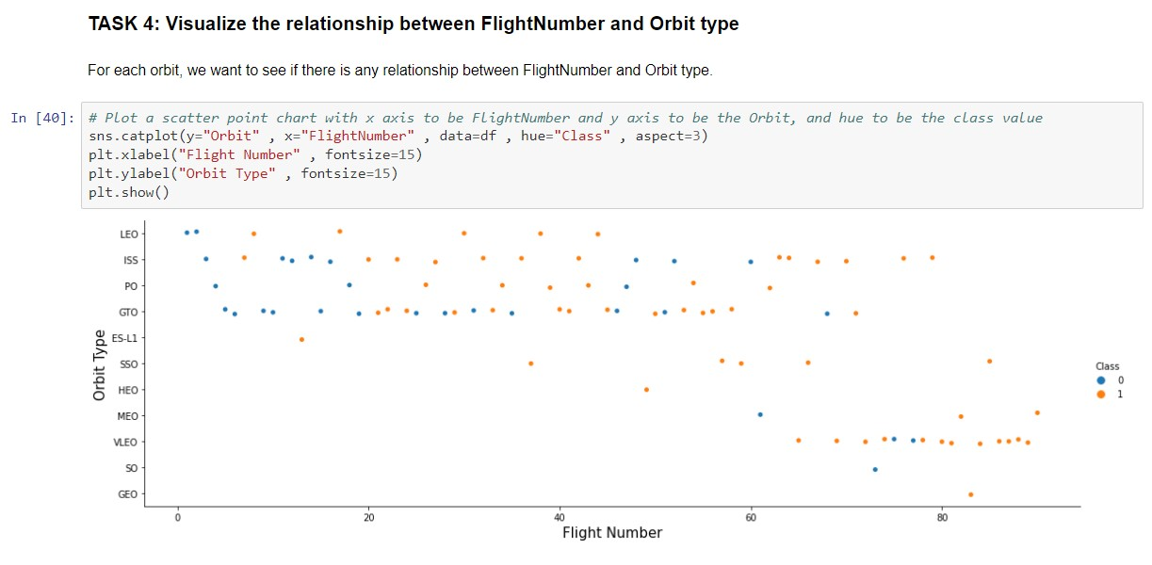
Flight Number vs. Orbit Type
Observations of scatter plot of Flight Number vs. Orbit Type:-
Success rate in LEO orbit increases with increase in Flight number.
Orbit VLEO has higher success rate when flight number is more than 60.
Orbits SSO, HEO, GEO and ES-L1 have 100% success rate, irrespective of number of flights.

Slide 22
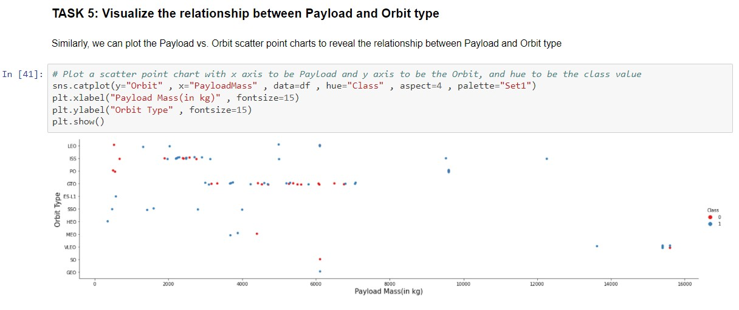
Payload vs. Orbit Type
Observations of scatter plot of Payload Mass vs. Orbit Type:-
Success rates of orbits LEO, ISS, PO increases with heavy payloads.
SSO, HEO, ES-L1 have successful landings with lighter payloads.
For orbit GTO no relationship observed.

Slide 23
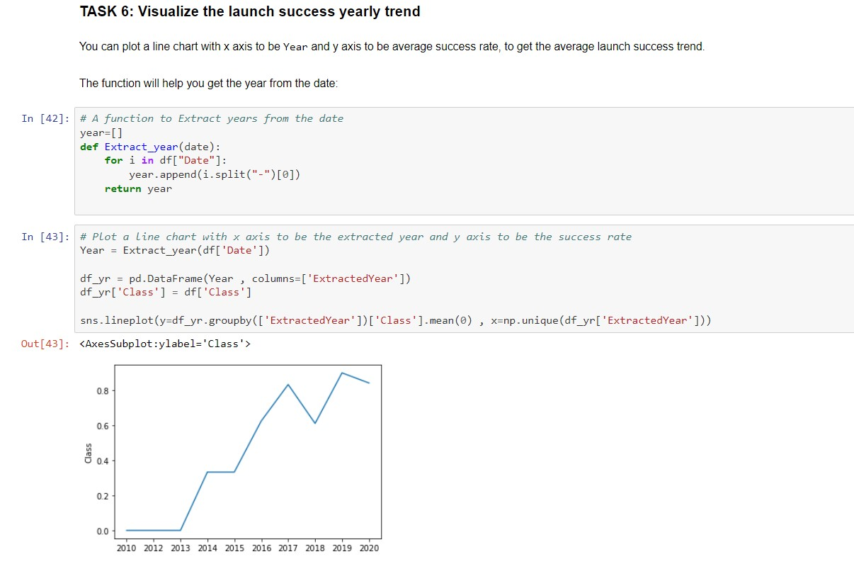
Launch Success Yearly Trend
Observations of line plot of Launch Success yearly trend:-
Since 2013, the launch success rate kept increasing till 2020, with a drastic downfall in 2018.

Slide 24
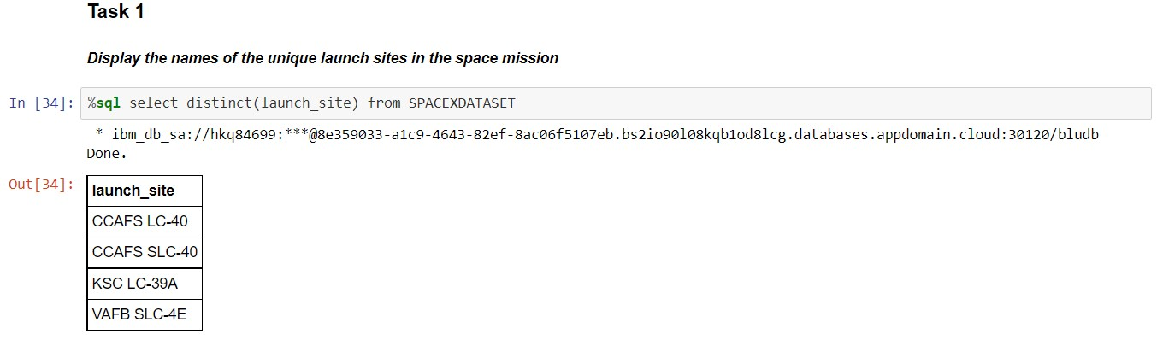
All Launch Site Names
Used DISTINCT with SELECT statement to find unique launch site names.

Slide 25
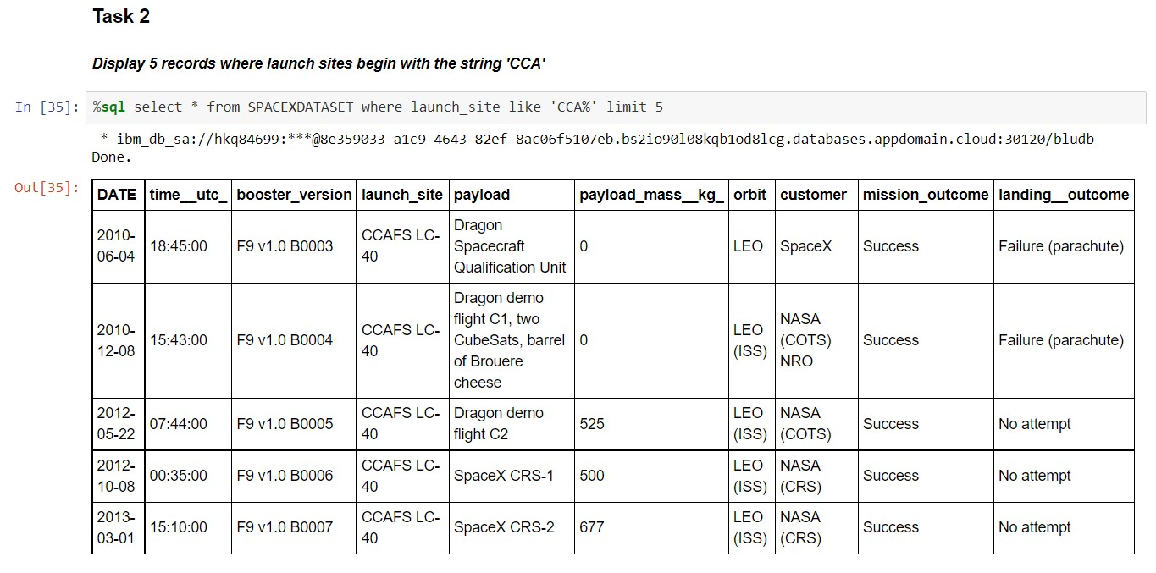
Launch Site Names Begin with 'CCA'
Used LIMIT with SELECT statement to get first 5 rows WHERE launch site starting with ‘CCA’

Slide 26
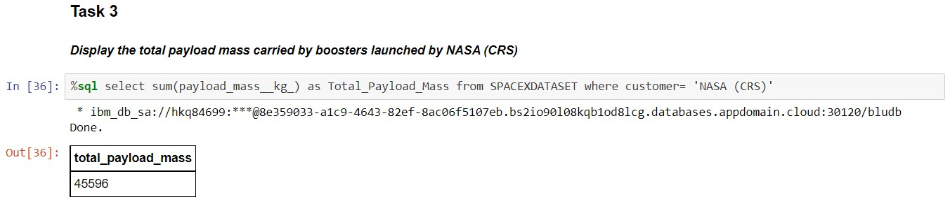
Total Payload Mass
Used SUM() function with SELECT statement to get total payload mass of NASA(CRS)

Slide 27
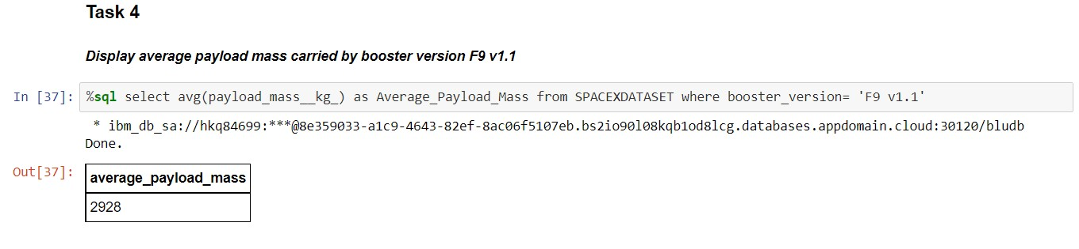
Average Payload Mass by F9 v1.1
Used AVG() function with SELECT statement to get average payload mass carried by booster version F9 v1.1

Slide 28
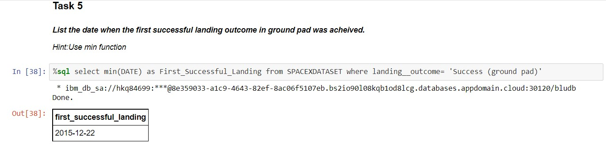
First Successful Ground Landing Date
Used MIN function with SELECT statement to get date of the first successful landing outcome on ground pad

Slide 29
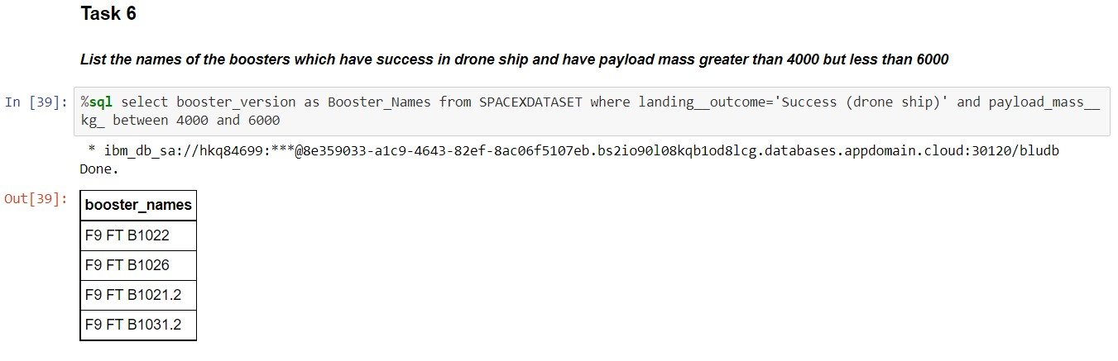
Successful Drone Ship Landing with Payload between 4000 and 6000
Used AND to satisfy 2 conditions in 1 query and obtain boosters which have successfully landed on drone ship and had payload mass greater than 4000 but less than 6000

Slide 30
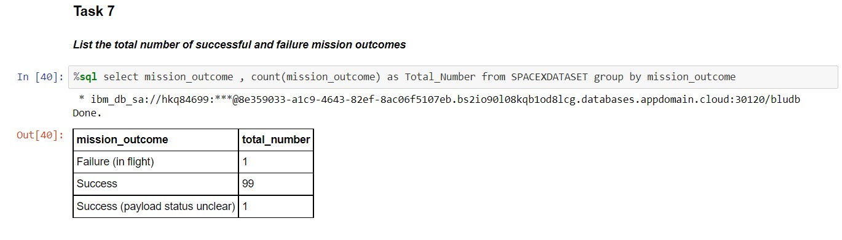
Total Number of Successful and Failure Mission Outcomes
Used COUNT function with SELECT statement to total number of mission outcomes, grouped by type of mission outcome.

Slide 31
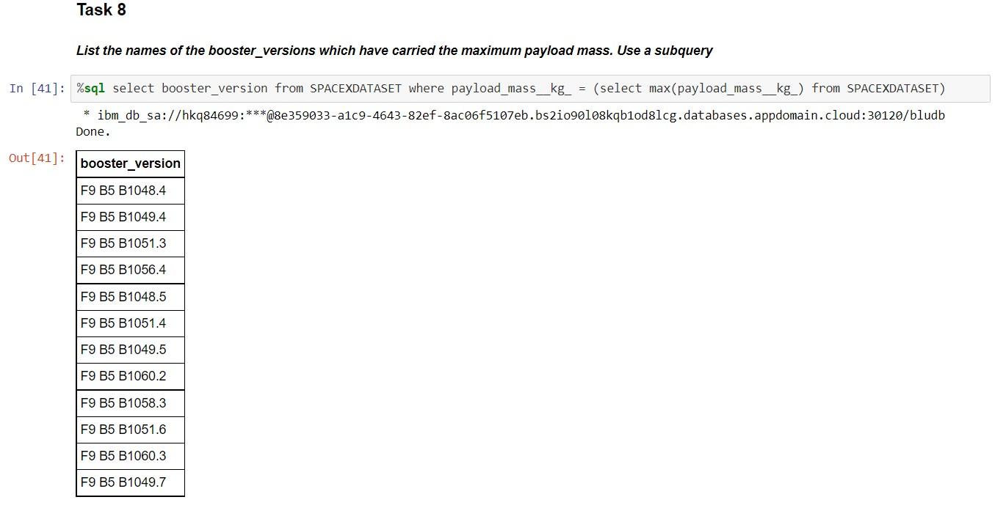
Boosters Carried Maximum Payload
Used a subquery and MAX() function to list booster names which have carried the maximum payload mass.

Slide 32
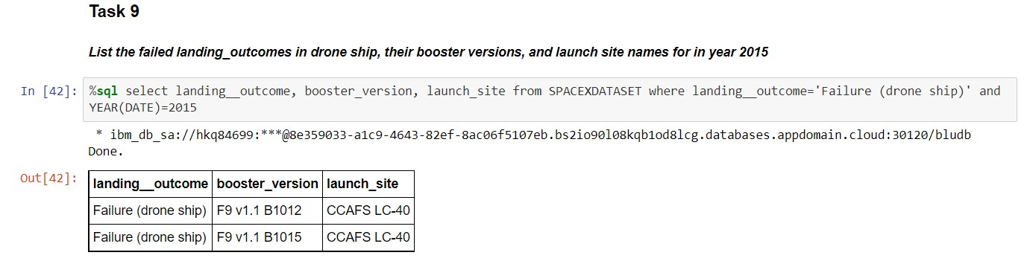
2015 Launch Records
Used AND to satisfy 2 conditions in 1 query and failed landing outcomes in drone ship, their booster versions, and launch site names for in year 2015 using YEAR() function.

Slide 33
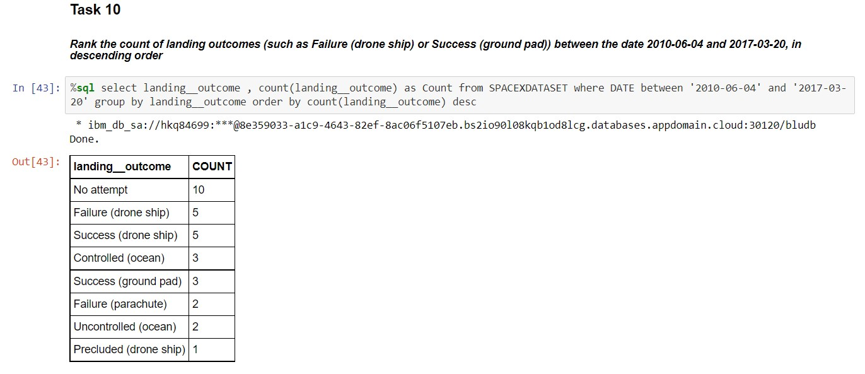
Rank Landing Outcomes Between 2010-06-04 and 2017-03-20
Used AND to satisfy 2 conditions in 1 query and rank the count of landing outcomes grouped by type of outcome between the date 2010-06-04 and 2017-03-20 using GROUP BY clause, in descending order using ORDER BY clause.

Slide 34

Section 3

Slide 35
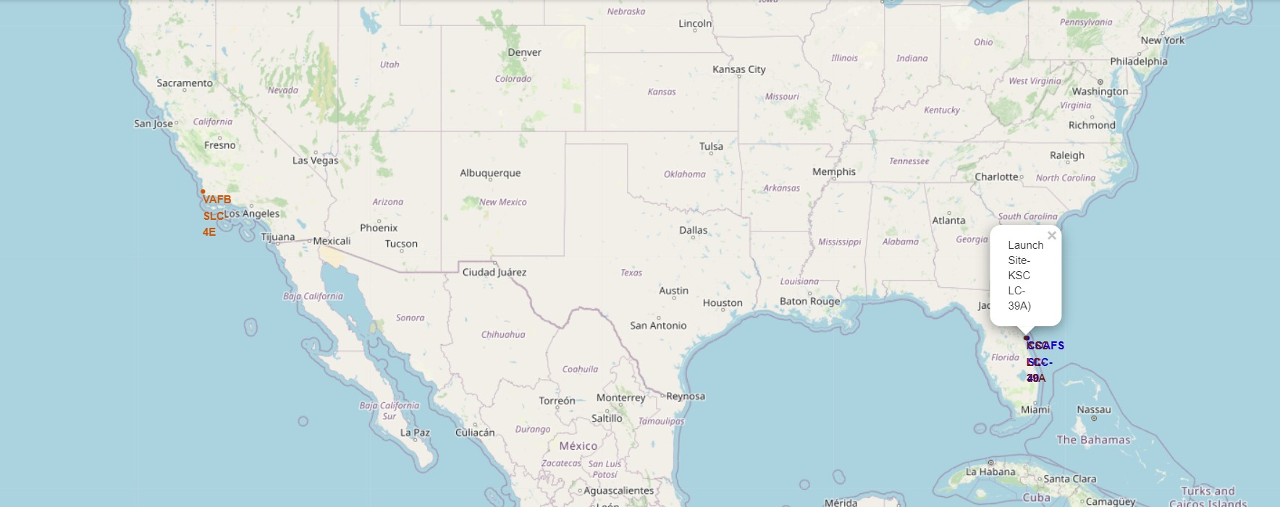
Visualize Launch Sites
Launch Site VAFB SLC-4E is located on farther west as compared to the other 3 sites, which are in proximity.
The launch sites are in proximity to the coast but far away from the Equator line.

Slide 36
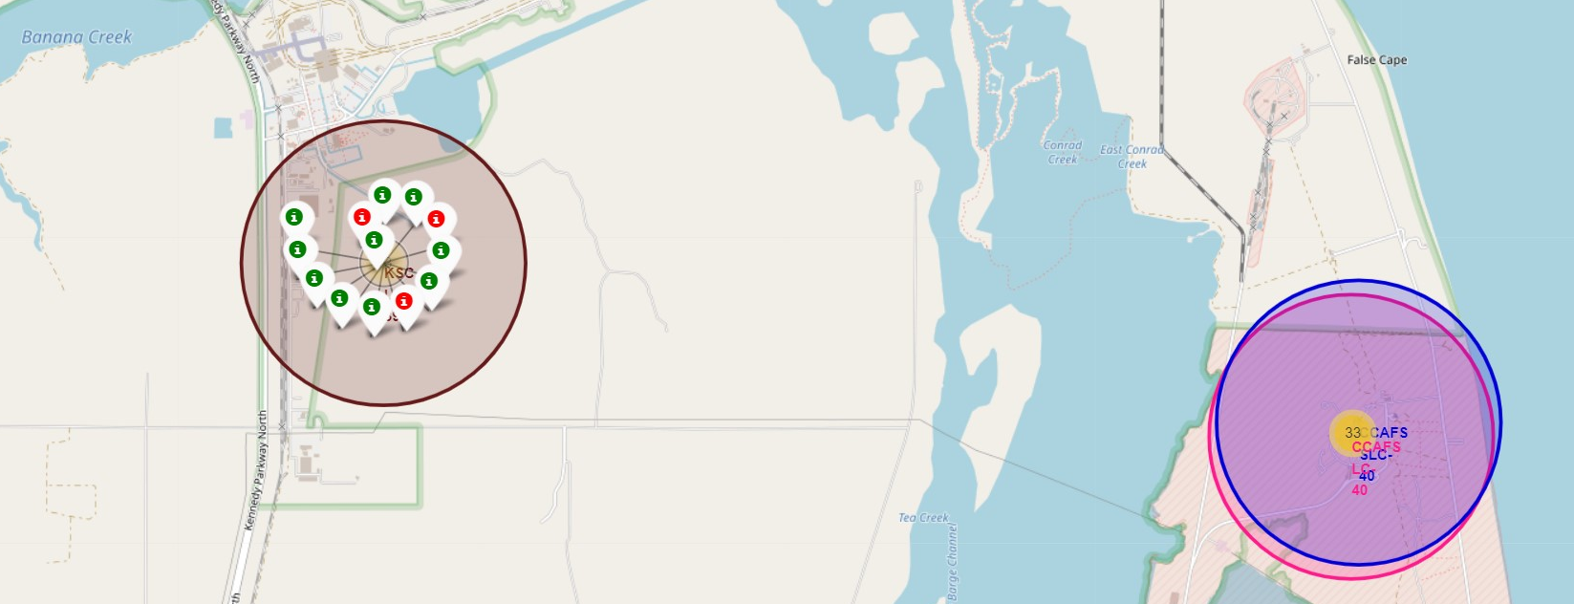
Visualize launch outcome of each site
Launch Site KSC LC-39A has the highest success rate of approximately 77%.
Launch Site CCAFS LC-40 has the lowest success rate of approximately 27%

Slide 37
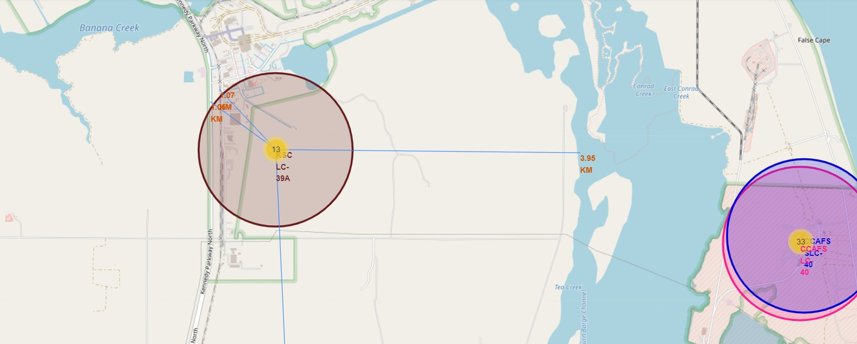
Calculate distance of sites to its proximities
The launch sites are in close proximity to railways, highways and coastline.
The launch sites are usually located far away from the cities.

Slide 38

Section 4

Slide 39
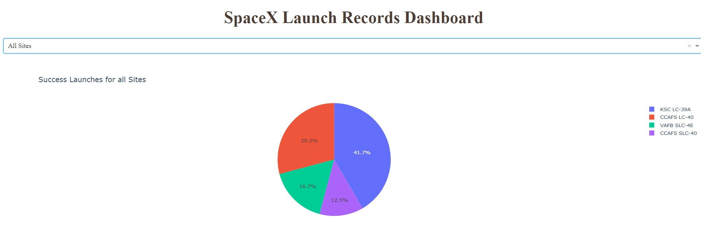
Compare success rates of all sites
Selecting All Sites from dropdown, shows pie chart of total successful launch for all four sites.
KSC LC-39A has the highest number of success launches.

Slide 40
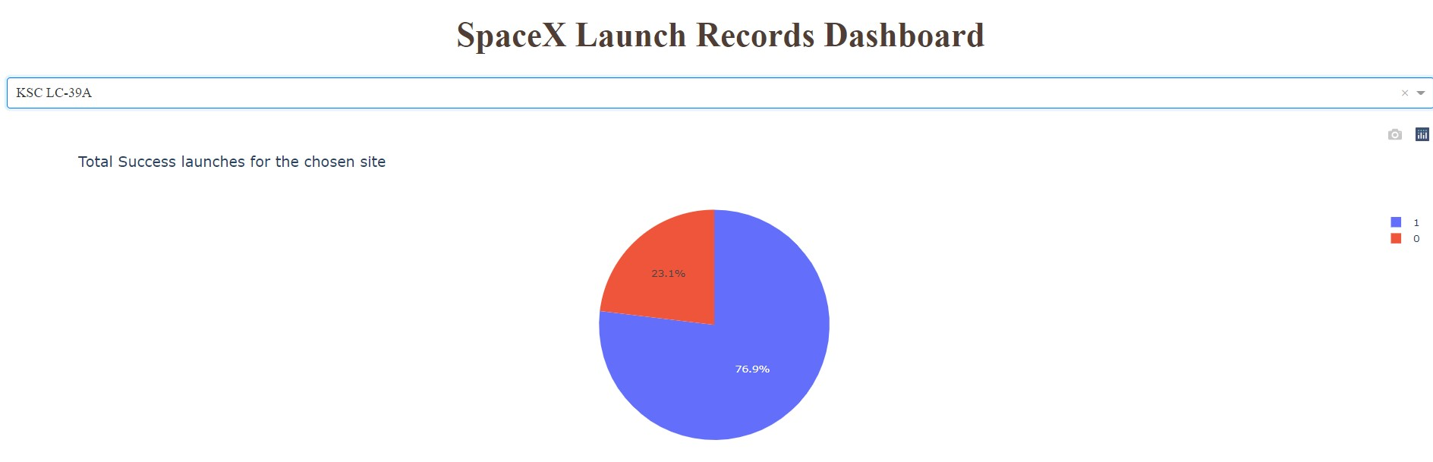
Success launches of chosen site
Success rate of launch site KSC LC-39A is 76.9%, which denotes out of all the launches from this site, the first stage of most launches land successfully and hence can be reused.

Slide 41
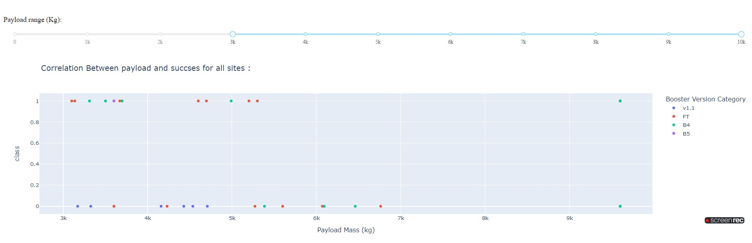
Correlation between payload and success rate
Altered the range of payload mass by sliding to 3000kg-10000kg.
From scatter plot we observe, booster version FT has a high success rate within selected range of payload mass whereas no success with booster version v1.1.

Slide 42

Section 5

Slide 43
Classification Accuracy
All the four classification models have the same Accuracy Score which is 0.833.
Hence cannot determine the best out of the four models that has highest classification accuracy.

Slide 44
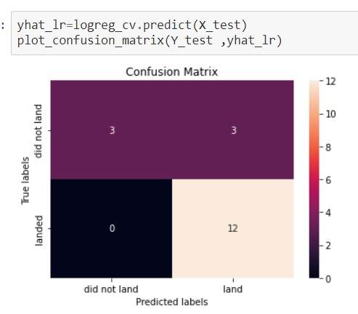
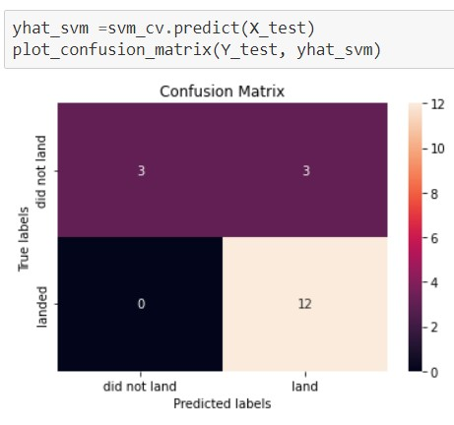
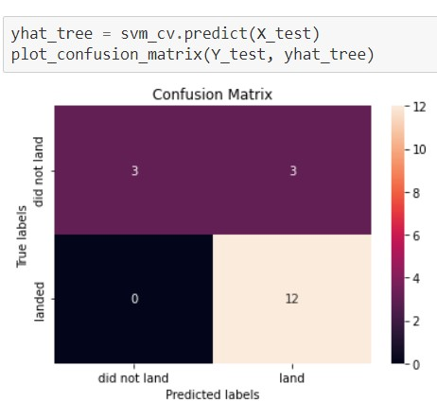
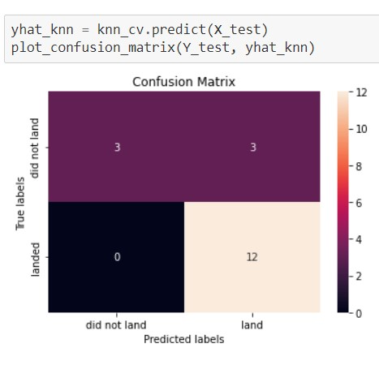
Confusion Matrix
As observed in previous results, all the four models have the same Accuracy Score and its difficult to determine the best classification model.
The Confusion Matrices of each model depicts similar performance of each model.
Logistic Regression
SVM
Decision Tree
K-Nearest Neighbor

Slide 45
Conclusions
Launch Site KSC LC-39A has the highest success rate of landing and is more preferable for launches where first stage needs to be reused.
To have more successful landings, orbits ES-L1, GEO, HEO, SSO can be chosen.
As the number of flight increases, the first stage is more likely to land successfully, thereby more chances of it to be reused.
The best accuracy of classification model is 0.833.
Starting from 2013, there has been an increase in successful landings and so with the classification model we may predict an increase in successful first stage landings which will lead to cost reduction of each launch.

Slide 46
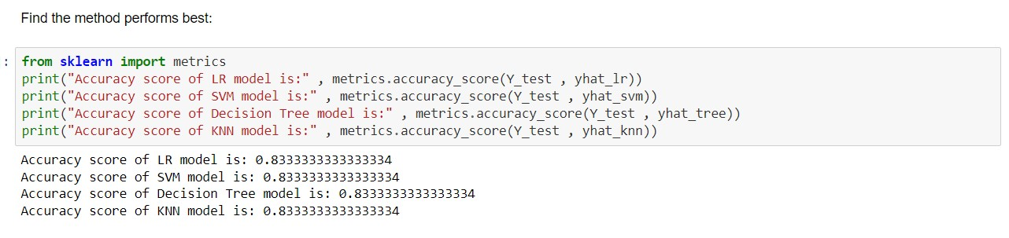
Appendix
The Python code to obtain the Test Accuracy Score using the method accuracy_score() and comparing with the models created is as below:

Slide 47


